Slide 1

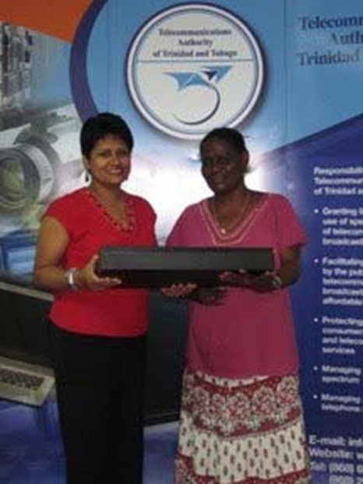
Information and Communication Technology to Optimise a Community
Diabetes Prevention and Education in Rural Tobago
Presented to
Telecommunications Authority of Trinidad and Tobago (TATT) 20/03/2015

Slide 2
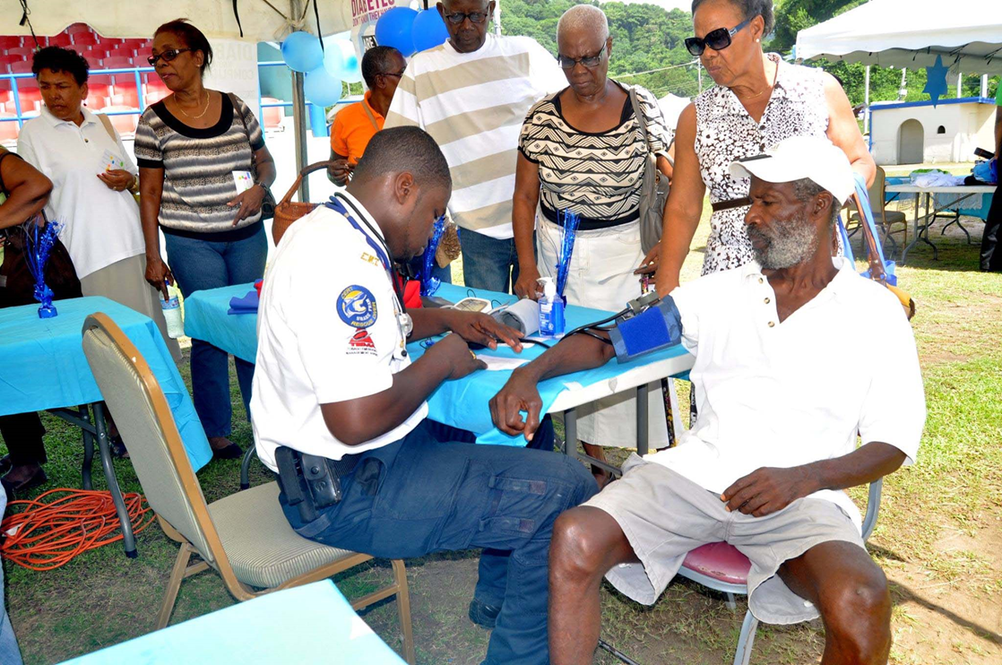
Bovell Cancer Diabetes Foundation (BCDF) – Use of the equipment

Slide 3
Background
The Organisation
The Bovell Cancer Diabetes Foundation (BCDF) is a
(non-governmental organisation) NGO based in
Tobago
Mission
Our mission is enriching lives of people living with
cancer and diabetes by providing resources and
education

Slide 4
Background
Vision
Our vision can be summed up in two words;
enriching lives
Long Term Goal
To have residents of Tobago and ultimately Trinidad routinely fit diabetes prevention, control and self-management strategies in their everyday lifestyles to improve their quality of life (QOL)

Slide 5
Background
Grant Information
Funding Agency: Telecommunication Authority of Trinidad and Tobago (TATT)
Year: 2013
Project Title
Information and Communication Technology to
Optimise a Community Diabetes Prevention and
Education in Rural Tobago

Slide 6
Background
Project Objective
To expand the range and reach of an existing structured community diabetes education, prevention, control and self-management programme available to individuals/families and communities in Tobago who have, or are at risk for diabetes mellitus

Slide 7
Background
The Bovell Cancer Diabetes Foundation (BCDF) hosts the following events to achieve our objectives and long-term goal:
    An annual “Diabetes in the Limelight Jamboree”
    Small group workshops
    Annual Breakfast and Diabetes awareness Dialogue Morning

Slide 8
Background
The Bovell Cancer Diabetes Foundation (BCDF) hosts the following events to meet and improve our objectives and long-term goal:
Publication of books
    Diabetes Education and Prevention Instructional Module for Children
    Diabetes Workbook: A BCDF Project
    Quarterly Newsletter – Diabetes Dialogue

Slide 9
Background
The Bovell Cancer Diabetes Foundation (BCDF) hosts the following events to meet and improve our objectives and long-term goal:
Online audience:
    Website
    Newsletter (Diabetes Dialogue)
    Facebook page
    Google group
    Android Application

Slide 10
Background
The following slides demonstrate how the Bovell Cancer Diabetes Foundation (BCDF) has used the equipment awarded to us in 2013 by TATT to enhance and really improve these events/activities
Equipment
    Outdoor screen
    Two laptops
    Projector
    PA System

Slide 11
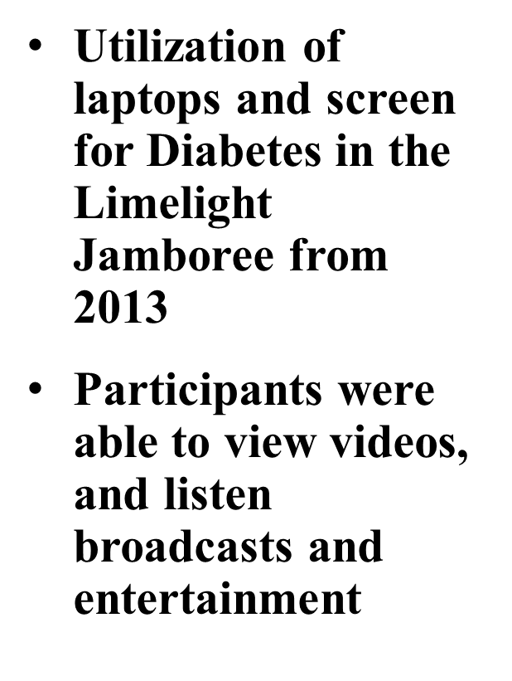
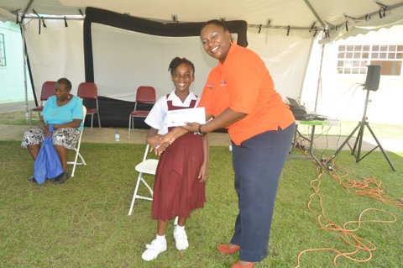
Diabetes in the Limelight Jamboree
Utilization of Laptops and Screen

Slide 12
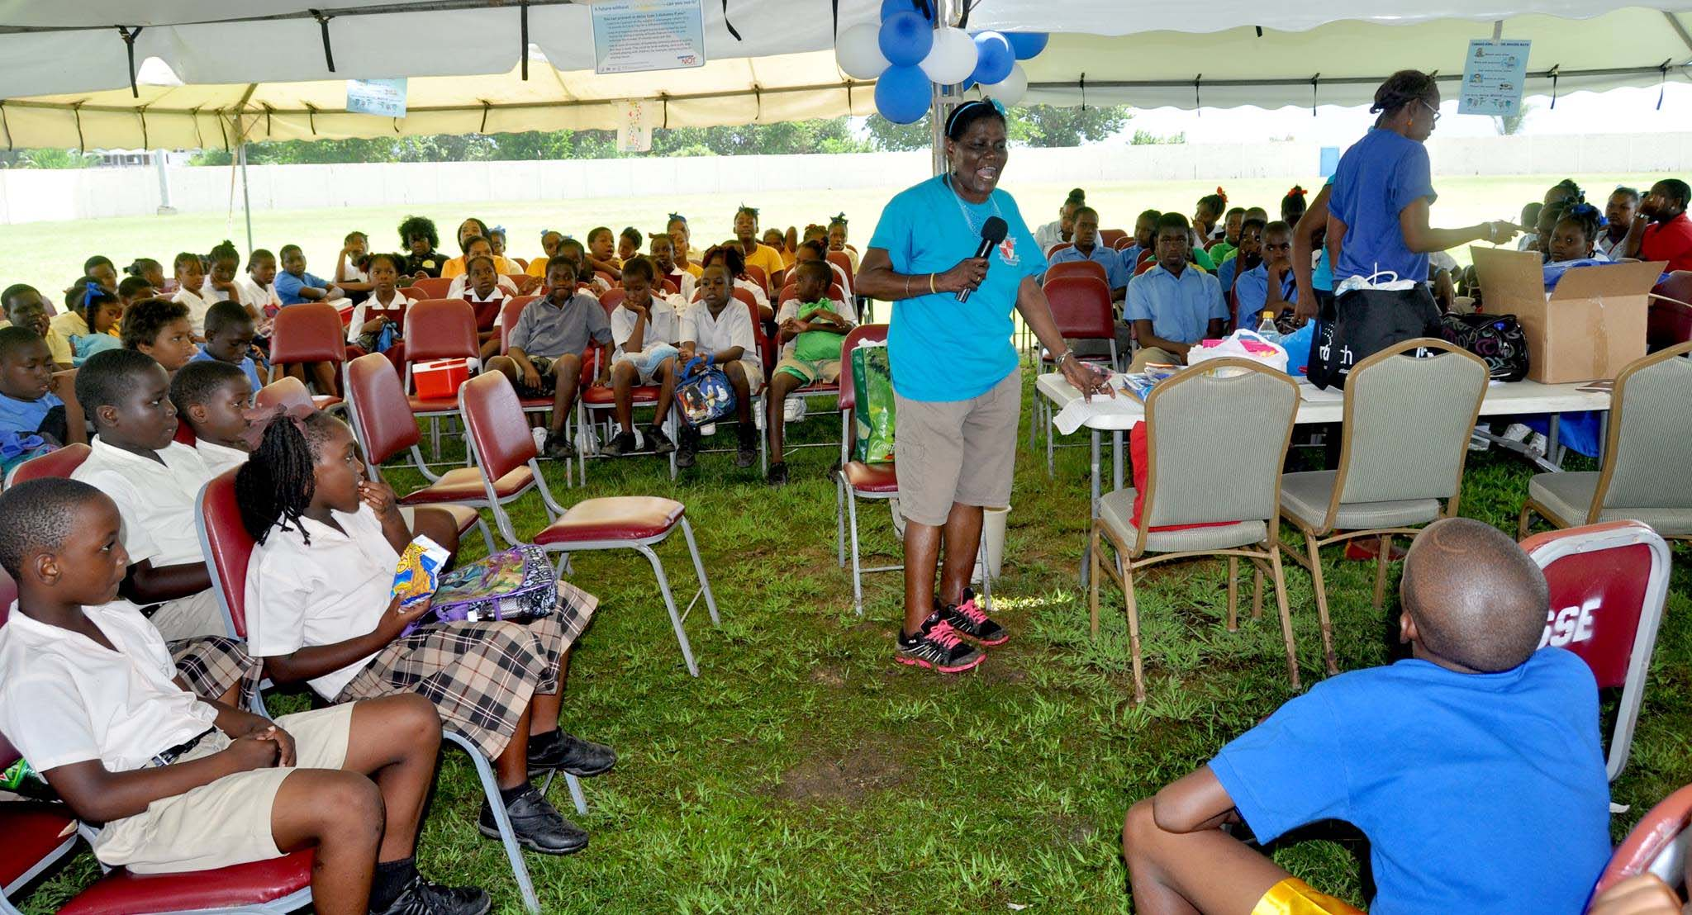
Diabetes in the Limelight Jamboree
Using the Public Address System

Slide 13
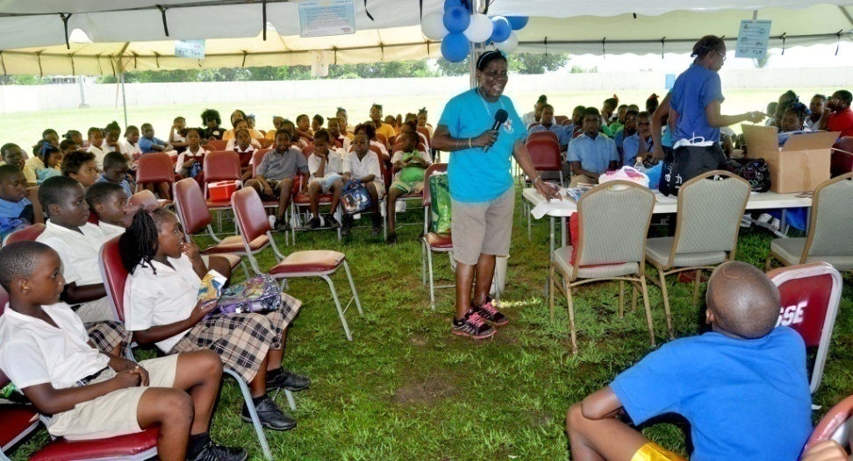
Diabetes in the Limelight Jamboree
PA system in use for storytelling at the annual Jamboree
So far from 2013, 500 students have listened to diabetes storytelling session at the Jamboree
Using the public address system

Slide 14
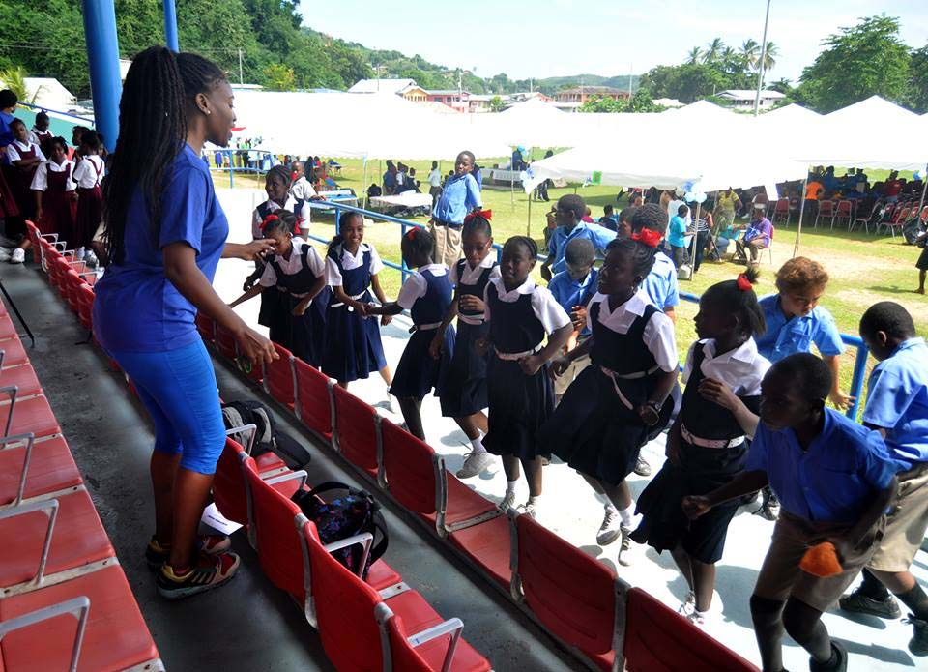
Diabetes in the Limelight Jamboree
PA system in use for Zumba exercises at the Annual Diabetes in the Limelight Jamboree
System is in background broadcasting the music
Using of the public address system

Slide 15
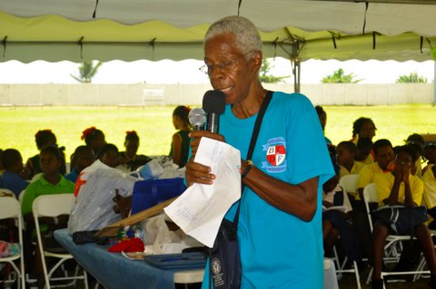
Diabetes in the Limelight Jamboree
The PA system being used by the emcee to inform attendees about diabetes and BCDF during the event
The screen (background) was used to project streaming videos

Slide 16
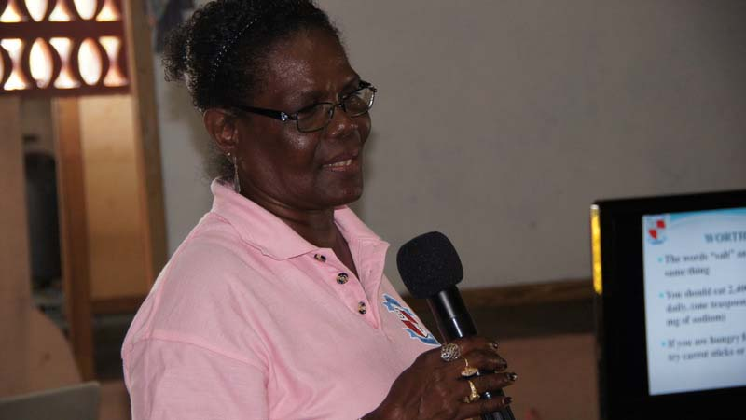
Small Group Workshops
PA system being used to amplify speeches/
instructions for
workshop groups
Laptops and the projector are used to present material to workshop groups

Slide 17
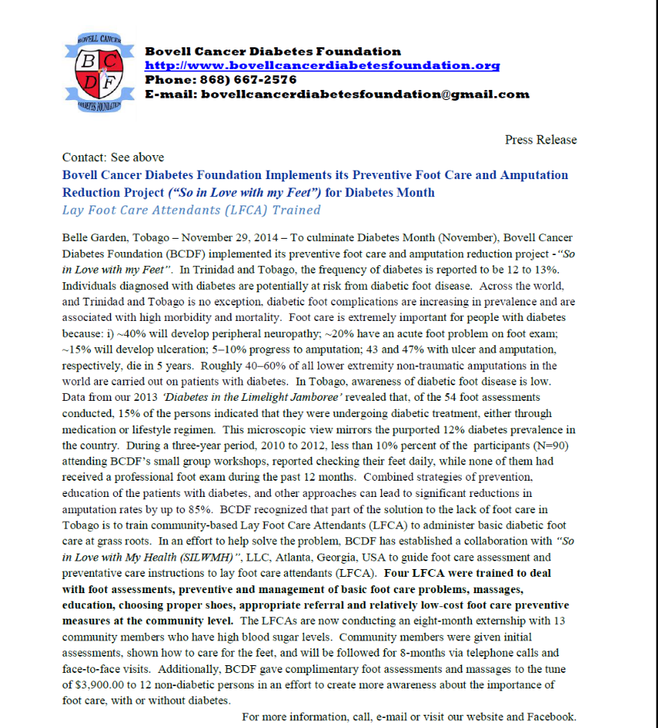
Word Processing Activities
Use of computers for word processing activities is a constant, daily event
Press releases

Slide 18
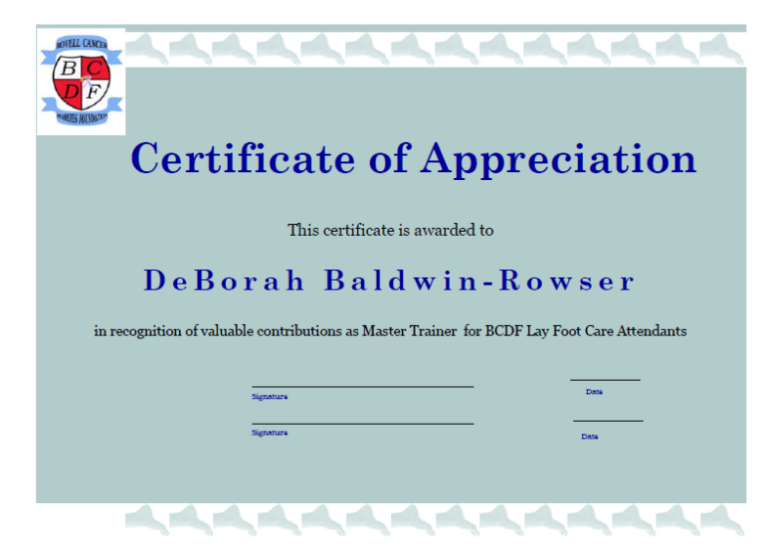
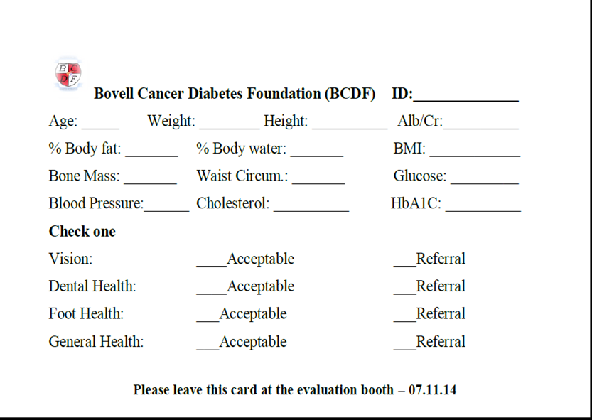
Word Processing Activities
Use of computers for word processing activities is a constant, daily event
    Certificates for volunteers
    Documentation for Annual Diabetes in the Limelight Jamboree

Slide 19
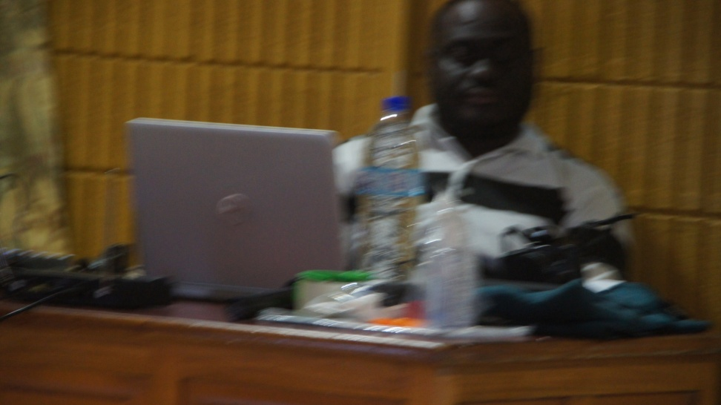
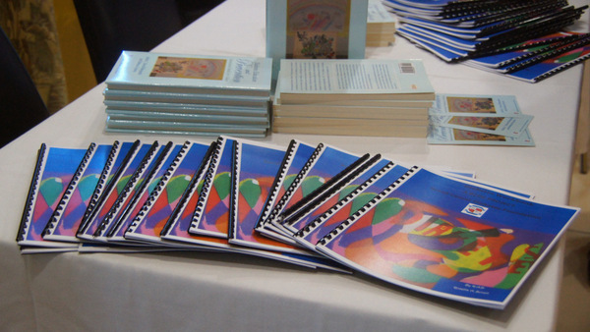
Publication of Books
The computers have been utilised to write two books, which are on sale:
Diabetes Education and Prevention: An Instructional Module for Children
Available from BCDF, Amazon, Barnes and Noble, in Kindle format
Diabetes Workbook: A BCDF Project, available from BCDF

Slide 20
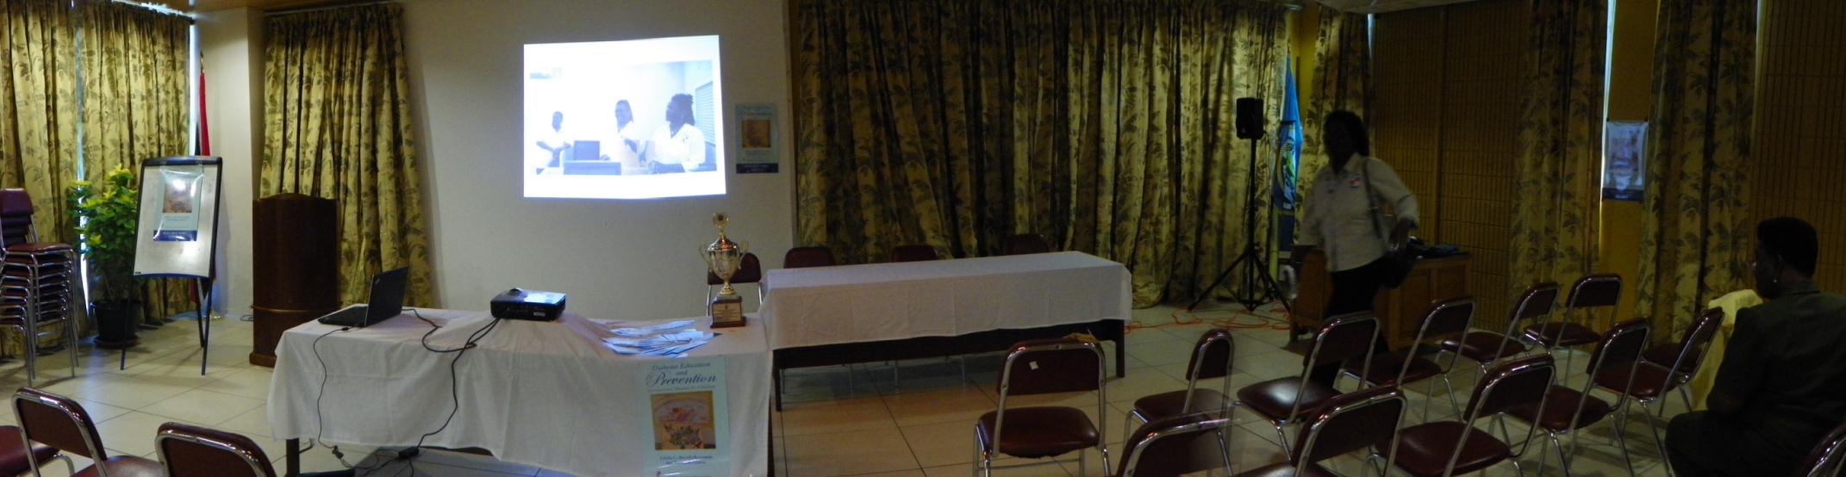
Publication of Books
LCD Projector, Laptop, PA System
All used in the production and launch of the two books
  Diabetes Education and Prevention Instructional Module for Children
  Diabetes Workbook: A BCDF Project

Slide 21
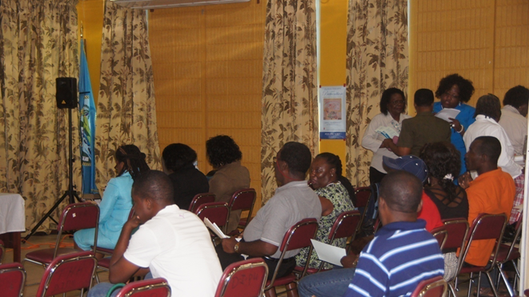
Publication of Books
The computer and projector were used to project images
The PA system was used to amplify sound of speakers

Slide 22
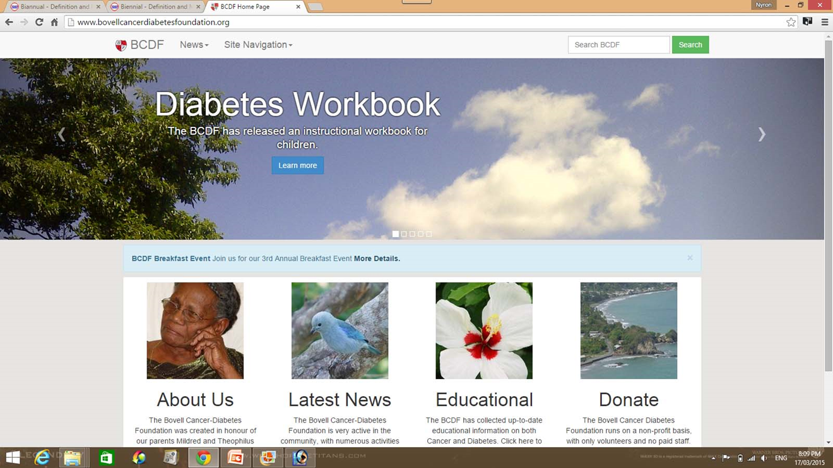
Bovell Cancer Diabetes
Foundation Website
The computers were used to create and upgrade the BCDF website
http://www.bovellcanc erdiabetesfoundation.org/

Slide 23

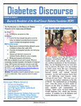

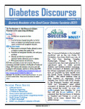
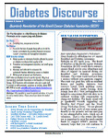
Diabetes Discourse
(Quarterly Newsletter)
The computers are used in the quarterly publication of the Diabetes Discourse
On-line listserv
  580 plus
Hardcopies
  200 per quarter (funds to print are a constraint)

Slide 24
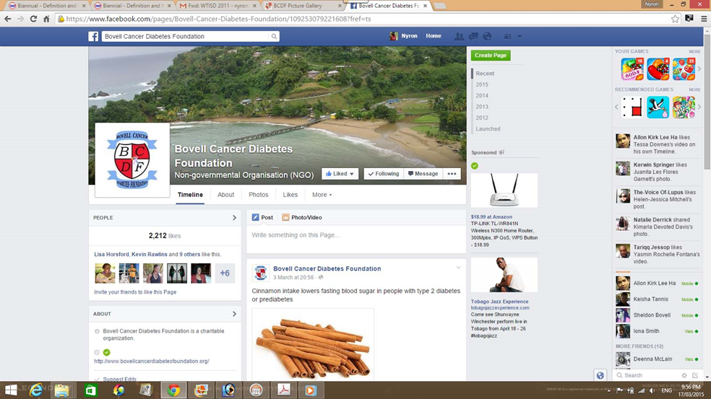
BCDF Facebook
Computers are used to keep us on our Facebook
Roughly 2,240 followers
Important diabetes awareness and education messages are posted regularly

Slide 25
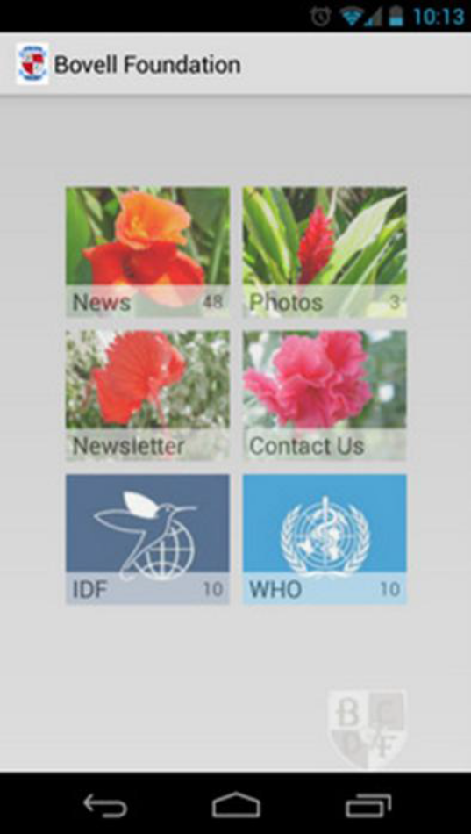
BCDF Android Application
Use of laptops to create a BCDF Android Application
BCDF used the computers given and Internet access to create and launch its Android application to help Tobago, Trinidad and the world to keep abreast of our activities
Features of the App include:
    Quick access to all of the BCDF news stories, formatted for phones (for rural Tobagonians), Internet access is available on their mobile phones
    Ability to view BCDF event picture galleries on the phone

Slide 26
BCDF Android Application
Use of laptops to create a BCDF Android Application
Features of the App include:
    Download the Quarterly BCDF newsletter, Diabetes Discourse
    Share contents from the app with friends
    Easy access to contact the BCDF
    Continuous updated news stories from IDF and the World Health Organization (WHO)

Slide 27
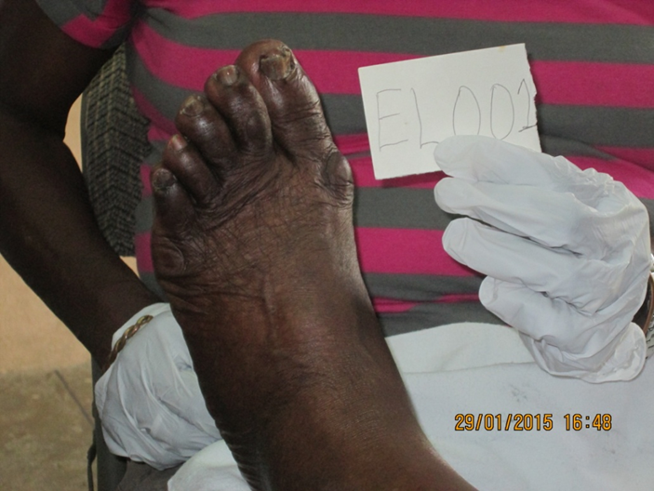
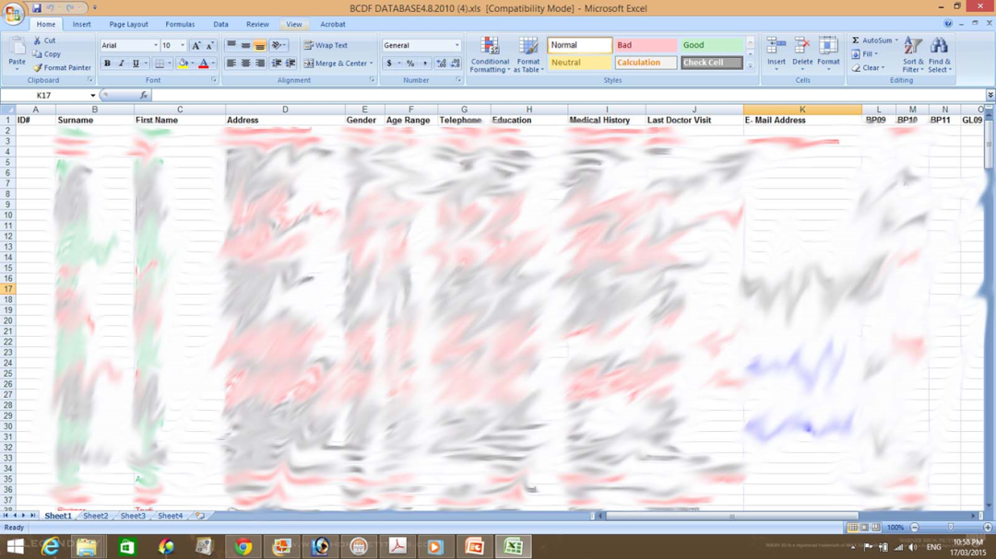
So in Love With My Feet Project
Laptops are used to create and store databases for this project

Slide 28
Overall Impact of the Equipment
Number of persons who benefited from the equipment:
Total number of persons to benefit from the project since BCDF acquired the equipment is about 6,000; Facebook followers are about 2,000 plus
Website educational information (about 200 persons based on feedback)

Slide 29
Overall Impact of the Equipment
Number of persons who benefited from the equipment:
One-on-one education is about 12 persons
We were also able to use the computers to upgrade our website at no additional cost to BCDF

Slide 30
Overall Impact of the Equipment
Benefits derived by community from the equipment
Roughly 6,000 or more community members with diabetes or at-risk for diabetes:
    gained knowledge and better understanding of diabetes prevention, control and management, thus being able to apply the knowledge to reduce the risk and prevalence of diabetes in communities
    community members also gained more diabetes-related coping skills

Slide 31
Overall Impact of the Equipment
Benefits derived by community from the equipment
Roughly 6,000 or more community members with diabetes or at-risk for diabetes:
    they also learnt basic steps of diabetes prevention and management, that is: healthy eating, be physically active, regular blood sugar checks, and using medications as prescribed
    Quality of life has been improved in these communities

Slide 32
Overall Impact of the Equipment
Project impact on the community from the equipment
The use of the equipment has made people more aware of the possibilities that the use of the Internet and other ICTs can bring to their communities, personal lives and economies

Slide 33
Overall Impact of the Equipment
Project impact on the community from the equipment
We have heard comments about how much technology the Foundation uses
Community members also understand how ICTs could be used to improve their health and quality of life

Slide 34
Overall Impact of the Equipment
Project impact on the community from the equipment
Economic impact on BCDF from the equipment
From an economic standpoint for BCDF, we have saved a lot of money since acquiring the equipment from TATT, which goes back into our programme, helping us to reach a larger number of persons

Slide 35
Overall Impact of the Equipment
Project impact on the community from the equipment
Economic impact on BCDF from the equipment
For example:
    We process our own newsletter, do not have to pay
    Do not have to pay for a PA system or DJ at our events

Slide 36
Overall Impact of the Equipment
Project impact on the community from the equipment
Economic impact on BCDF from the equipment
For example:
    We have used Publisher to create our own brochures for the Jamboree and workshops
    Excel to create our participant databases, evaluation forms etc.

Slide 37

THANK YOU
The Board of Directors of the Bovell Cancer Diabetes Foundation expresses its gratitude to the Telecommunications Authority of Trinidad and Tobago for the award

