Slide 1

HEALTHY EATING AND DIABETES WORKSHOP
UNDERSTANDING FOOD
1^{ST &} 2ND JULY, 2015
BELLE GARDEN COMMUNITY CENTRE
BELLE GARDEN, TOBAGO

Slide 2

UNDERSTANDING FOOD
Main sources of calories in food
To begin with, let us talk about food in general
We get nutrients from the foods we eat
Foods supply us with energy, or calories
To keep our bodies running, we need three main types of food:
Carbohydrate Minerals
Protein Vitamins
Fat Water, Fibre

Slide 3
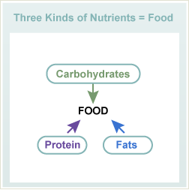
UNDERSTANDING FOOD
Main sources of calories in food

Slide 4
UNDERSTANDING FOOD
Calories in food
All foods are not equal in calories
    Fat, for example, has more than twice the calories, gram for gram, as equal amounts of carbohydrates or protein
Fat = 9 calories per gram
Carbohydrate = 4 calories per gram
Protein = 4 calories per gram

Slide 5
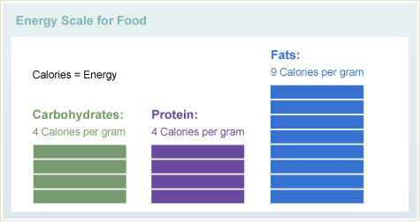
UNDERSTANDING FOOD
Energy scale for food

Slide 6
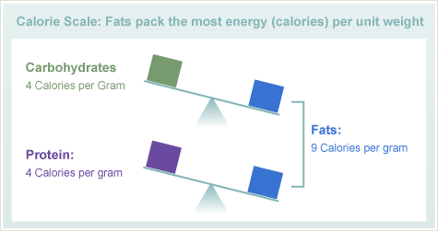
UNDERSTANDING FOOD
Calorie scale for nutrients

Slide 7
UNDERSTANDING FOOD
How much carbohydrate, protein and fat do I need each day?
The typical range is:
    Carbohydrates – 45 to 65% of your daily calories
    Protein – 10 to 35% of your daily calories
    Fat - 25 to 35% of your daily calories
    This is the case whether you have or do not have diabetes

Slide 8
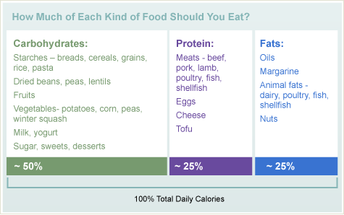
UNDERSTANDING FOOD
How much of each kind of food should we eat?

Slide 9
UNDERSTANDING FOOD
Carbohydrates
If you have diabetes, you have to know about
carbohydrates
Why?
    Among all the foods, carbohydrates have the
largest effect on your blood sugar
    Carbohydrates include starch and sugars

Slide 10
UNDERSTANDING FOOD
Carbohydrates
During digestion, both forms of carbohydrate break down in your body to single units of sugar, called glucose
Carbohydrate is an important part of your diet because the most common sugar unit, glucose, is your body’s preferred source of energy or fuel
You do not need to avoid carbohydrates because of diabetes - just be able to identify which foods have carbohydrates, and then control the amount you eat

Slide 11
UNDERSTANDING FOOD
Carbohydrates are found in:
Rice, grains, cereals, and pasta (macaroni, spaghetti)
Bread, bakes, ground provision (yam, dasheen, sweet potato), salt biscuits (Crix)
Dried beans, split peas and lentils
Vegetables, like potatoes, corn, peas
Fruit Milk Yogurt
Sugars, like table sugar and honey
Foods and drinks made with sugar, like regular soft drinks and desserts

Slide 12
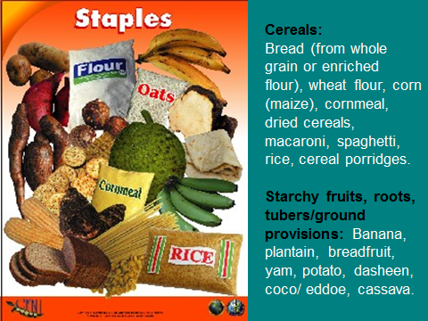
UNDERSTANDING FOOD

Slide 13
UNDERSTANDING FOOD
If you have type 1 diabetes, match your carbohydrate intake to your insulin dose. To get the best blood sugar result, your carbohydrate count must be accurate
Carbohydrates are counted in grams – and even a few grams more or less can make a difference in your blood sugar reading

Slide 14
UNDERSTANDING FOOD
Similarly, if you have type 2 diabetes, and are treated with medications that cause insulin to be released from the pancreas or insulin
    You also must match your carbohydrate intake to your medication dose
    To get the best blood sugar result, your carbohydrate count must be accurate

Slide 15
UNDERSTANDING FOOD
Proteins
Protein is an essential part of your diet — and your body
Too much of a good thing can be bad for you
Most meats have fat as well as protein
Excess protein from animal sources can mean excess calories and fat – which means a greater chance at gaining weight

Slide 16
UNDERSTANDING FOOD
Proteins are found in:
Beef and pork
Poultry
Fish and shellfish
Eggs
Dairy products, like regular cheese
Plant-based proteins, like beans and nuts

Slide 17
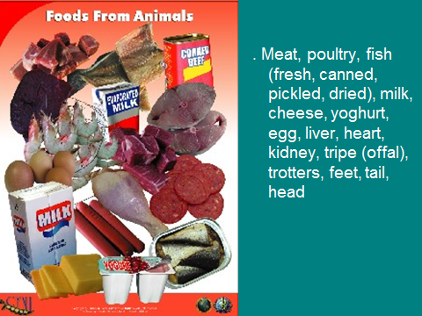
UNDERSTANDING FOOD

Slide 18
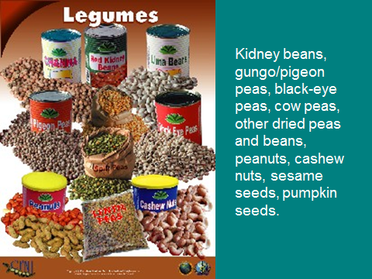
UNDERSTANDING FOOD

Slide 19
UNDERSTANDING FOOD
Advice about proteins
The best advice about protein: get what you need from low-fat protein sources like lean meats, poultry and fish, low fat or nonfat dairy products, and vegetarian protein sources like dried beans
If you have kidney problems, you may need to limit how much protein you eat

Slide 20
UNDERSTANDING FOOD
Fats
Fat is another important part of your diet
Remember that fat has twice the calories as equal amounts of carbohydrate or protein
Limiting the fat you eat will help you control your weight and prevent heart and blood vessel disease

Slide 21
UNDERSTANDING FOOD
Fats are found in:
Butter and margarine
Oils, like vegetable oil, olive oil and canola oil
Salad dressing and mayonnaise
Nuts and seeds

Slide 22
UNDERSTANDING FOOD
Fats are found in:
Meat and protein foods, like beef, cheese, bacon and hot dogs
Some fats and oils are heart healthy; others are not
Take the time to make low fat choices, and choose heart-healthy fats

Slide 23
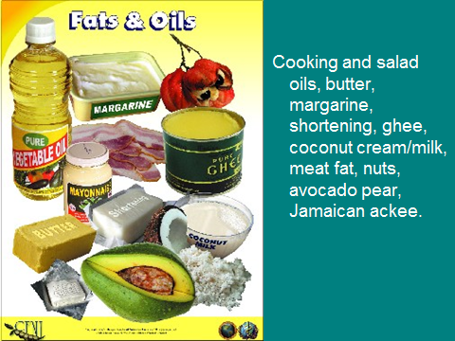
UNDERSTANDING FOOD

Slide 24
HOW TO EAT A BALANCED DIET
How to Eat a Balanced Diet
It is important to eat a varied and well-balanced diet, especially when you are trying to lose weight to manage your diabetes
Cutting calories should not lead to cutting nutrition

Slide 25
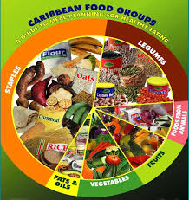
HOW TO EAT A BALANCED DIET

Slide 26
HOW TO EAT A BALANCED DIET
Exchange Lists for Diabetes: Choose Your Foods
In the exchange system, foods with a similar amount of carbohydrate, protein and fat per serving size are grouped together
The foods within each list can be “exchanged” for one another during meal planning and end up with about the same amount of calories and nutrients

Slide 27
HOW TO EAT A BALANCED DIET
Exchange Lists for Diabetes: Choose Your Foods
Of course, we don’t think of food as purely protein, purely fat or purely carbohydrate
Different foods are usually a mix of all three
To deal with this, we put food into six major exchange food groups based on each food’s main content:
    Staples Foods from animals
    Fruits Legumes
    Vegetables Fats and Oils

Slide 28
HOW TO EAT A BALANCED DIET
Food List |  | Carbohydrate (grams) | Protein (grams) | Fat (grams) | Calories
Carbohydrates
Staples |  | 15 | 0-3 | 0-1 | 80
Fruits |  | 15 | - | - | 60
Milk
 | Fat-free, low-fat, 1% | 12 | 8 | 0-3 | 100
 | Reduced-fat, 2% | 12 | 8 | 5 | 120
 | Whole | 12 | 8 | 8 | 160
Non-starchy Vegetables |  | 5 | 2 | - | 25

Slide 29
HOW TO EAT A BALANCED DIET
Food List | Carbohydrate (grams) | Protein (grams) | Fat (grams) | Calories
Foods from Animals
Lean | varies | 7 | 0-3 | 45
Medium-fat | - | 7 | 4-7 | 75
High-fat | - | 7 | 8+ | 100
Plant-based proteins | varies | 7 | varies | varies

Slide 30
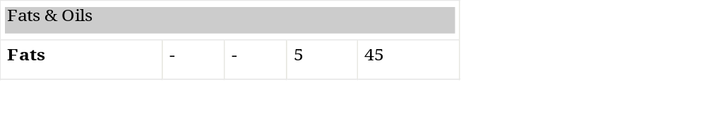
HOW TO EAT A BALANCED DIET
Food List | Carbohydrate (grams) | Protein (grams) | Fat (grams) | Calories

Slide 31
HOW TO EAT A BALANCED DIET
It is important to eat foods from all six lists
The exchange system is designed to help you eat a balanced diet with the right amounts of carbohydrate, protein and fat
No category of food is off limits

Slide 32
HOW TO EAT A BALANCED DIET
When learning to use the exchange system for the first time, follow these helpful steps:
Think about your usual foods and food preferences, and locate where each food falls on the exchange list
Familiarize yourself with the specific serving sizes listed for each food item that equal one exchange
Learn the number of exchanges you need from each food list to plan your daily meals and snacks

Slide 33
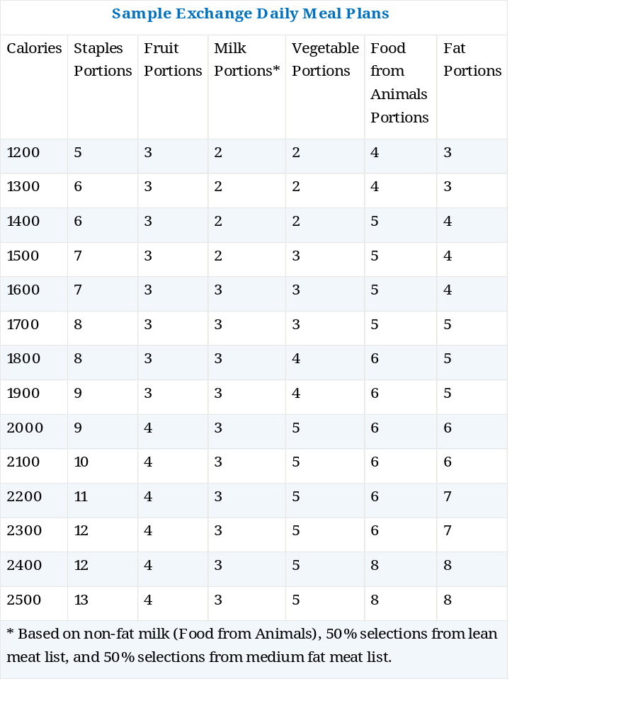
HOW TO EAT A BALANCED DIET
* Based on non-fat milk (Food from Animals), 50% selections from lean meat list, and 50% selections from medium fat meat list

